Slide 1
How to Restrict TinyMCE Formats

Slide 2
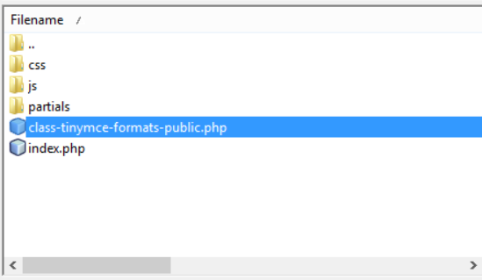
Finding the file to change:
The file to change is: class-tinymce-formats-public.php
In the folder
PressBooks-TinyMCE-Formats-master/public/

Slide 3
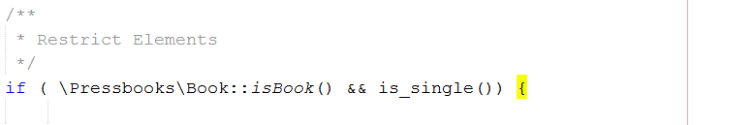
Where to add the code
In class-tinymce-formats-public.php, at the bottom in function
public function enqueue_scripts() {}.
You can add the new code inside the Restrict Elements If block

Slide 4
Adding new format restriction to php
Let’s say the new format name is: new_format
Find the last restriction in the file
Copy-paste and change like this:
Change the number to +1(to provide unique name), Change the name of js file and save.

Slide 5
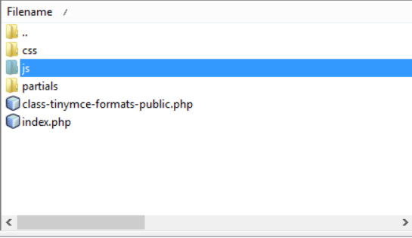

Adding the js file
After the changing php file, you need to add a js file inside the ‘js’ folder (in the same location with php file)
File name shoul be the same like in the php file

Slide 6
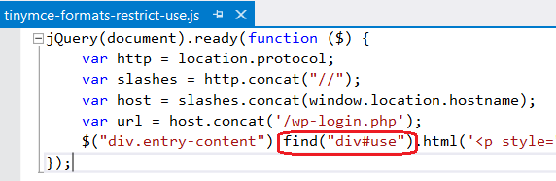
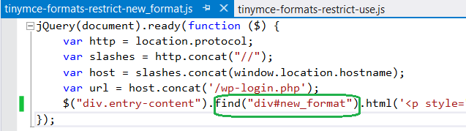
Final step, adding the js code
Just copy-paste from one of the other js files and only change the part ‘find("div#format_name")’

